Slide 1
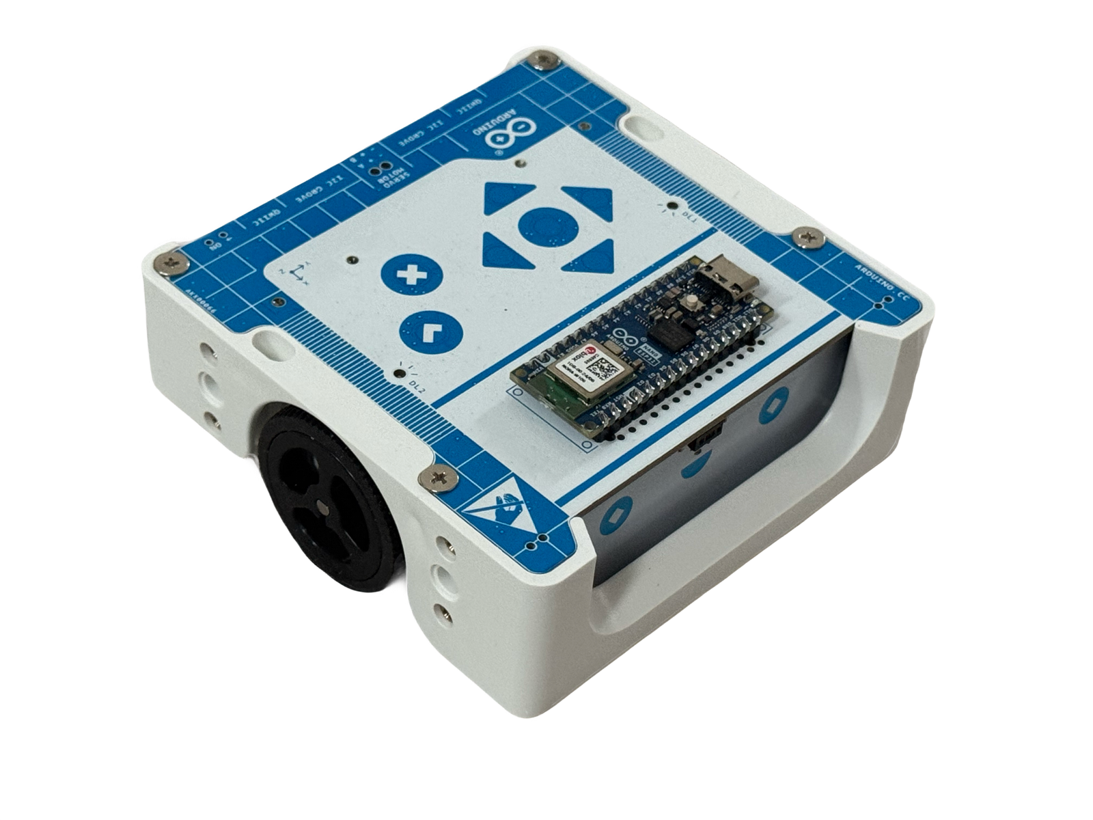
IR Sensors and Line Following with the Arduino Alvik Mobile Differential Robot

Slide 2
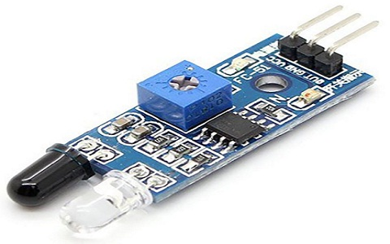
Light Emission & Reflection: The sensor has an IR LED that shines invisible light onto the ground.
Detection: A photodiode or phototransistor detects how much light is reflected back.
Contrast Detection:
White surfaces reflect more IR light.
Black surfaces (like a dark track line) absorb IR light, reflecting less.
Decision Making: The robot's microcontroller reads the sensor data and adjusts its movement to stay on the line.
Pin | Function | Connection Arduino/ESP32
VCC | Power Supply (5/3.3 V) | Arduino 5V / ESP32 3.3 V
GND | Ground | GND Arduino/ESP32
OUT | Signal Output | Connect to any analog or digital pin

Slide 3
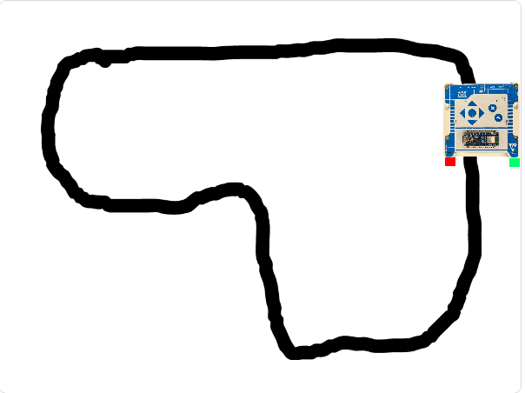
Let us use PictoBlox to create a simulation program to allow the robot drive itself following a line. We can draw our own map in PictoBlox or import a map. We can also import an image of our favorite robot in plan view with a transparent background. Add sensors to the robot using the built in Paint Box In this case we are using red on the left and green on the right

Slide 4
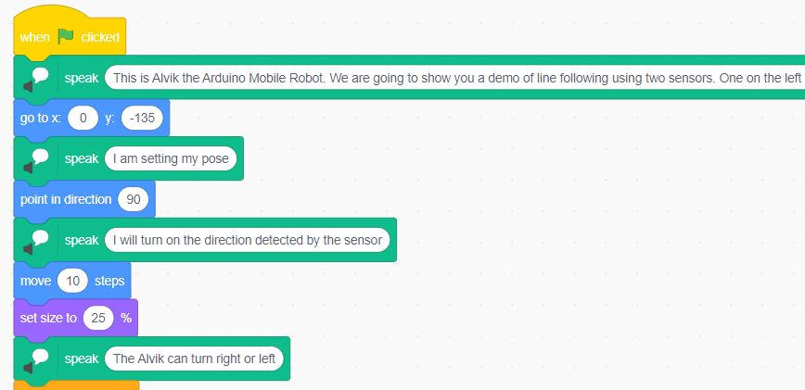
Program Setup. We can use text to voice blocks for instructions We can setup the pose of the robot Scaling if necessary Preliminary moves if required

Slide 5
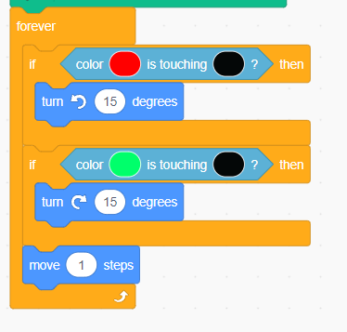
Program Steps
We establish a loop to keep the program running
The robot in PictoBlox uses color to sense.
We have a red sensor on the left and a green sensor on the right.
The decision is made when either the red or the black sensor touches the black line
We use conditional statements to compare colors and make decision to turn right or left
We then specify the motion block for each move.

Slide 6
For video check link to you tube

Slide 7
For video check YouTube link

Slide 8
Questions?

